Slide 1


Introduction: part 2
saliya@nsbm.lk
A note on the use of these Powerpoint slides:
We’re making these slides freely available to all (faculty, students, readers). They’re in PowerPoint form so you see the animations; and can add, modify, and delete slides (including this one) and slide content to suit your needs. They obviously represent a lot of work on our part. In return for use, we only ask the following:
Computer Networking: A Top Down Approach
If you use these slides (e.g., in a class) that you mention their source (after all, we’d like people to use our book!)
If you post any slides on a www site, that you note that they are adapted from (or perhaps identical to) our slides, and note our copyright of this material.
Thanks and enjoy! JFK/KWR
All material copyright 1996-2016
J.F Kurose and K.W. Ross, All Rights Reserved
7th edition Jim Kurose, Keith Ross Pearson/Addison Wesley April 2016

Slide 2
Introduction: roadmap
1.1 what is the Internet?
1.2 network edge
end systems, access networks, links
1.3 network core
packet switching, circuit switching, network structure
1.4 delay, loss, throughput in networks
1.5 protocol layers, service models
1.6 networks under attack: security
1.7 history
Notes:
2

Slide 3

How do loss and delay occur?
packets queue in router buffers
packet arrival rate to link (temporarily) exceeds output link capacity
packets queue, wait for turn
packet being transmitted (delay)
A
B
packets queueing (delay)
free (available) buffers: arriving packets
dropped (loss) if no free buffers

Slide 4
Four sources of packet delay
transmission
A
propagation
B
nodal
processing
queuing
d_{nodal} = d_{proc} + d_{queue} + d_{trans} + d_{prop}
d_{proc}: nodal processing
check bit errors
determine output link
typically < msec
d_{queue}: queueing delay
time waiting at output link for transmission
depends on congestion level of router

Slide 5
Four sources of packet delay
transmission
A
propagation
B
nodal
processing
queueing
d_{nodal} = d_{proc} + d_{queue} + d_{trans} + d_{prop}
d_{trans}: transmission delay:
L: packet length (bits)
R: link bandwidth (bps)
d_{trans} = L/R
d_{prop}: propagation delay:
d: length of physical link
s: propagation speed (~2x10⁸ m/sec)
d_{prop} = d/s
d_{trans} and d_{prop}
very different
* Check out the online interactive exercises for more examples: http://gaia.cs.umass.edu/kurose_ross/interactive/
* Check out the Java applet for an interactive animation on trans vs. prop delay
Notes:
5

Slide 6
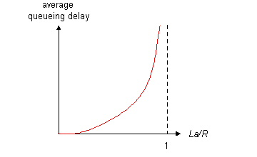

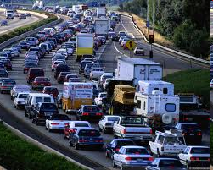
Queueing delay (revisited)
R: link bandwidth (bps)
L: packet length (bits)
a: average packet arrival rate
average queueing delay
traffic intensity
= La/R
La/R ~ 0: avg. queueing delay small
La/R -> 1: avg. queueing delay large
La/R > 1: more “work” arriving
than can be serviced, average delay infinite!
La/R ~ 0
La/R -> 1
* Check online interactive animation on queuing and loss

Slide 7
“Real” Internet delays and routes
what do “real” Internet delay & loss look like?
traceroute program: provides delay measurement from source to router along end-end Internet path towards destination. For all i:
sends three packets that will reach router i on path towards destination
router i will return packets to sender
sender times interval between transmission and reply.
3 probes
3 probes
3 probes

Slide 8
“Real” Internet delays, routes
traceroute: gaia.cs.umass.edu to www.eurecom.fr
3 delay measurements from
gaia.cs.umass.edu to cs-gw.cs.umass.edu
1 cs-gw (128.119.240.254) 1 ms 1 ms 2 ms
2 border1-rt-fa5-1-0.gw.umass.edu (128.119.3.145) 1 ms 1 ms 2 ms
3 cht-vbns.gw.umass.edu (128.119.3.130) 6 ms 5 ms 5 ms
4 jn1-at1-0-0-19.wor.vbns.net (204.147.132.129) 16 ms 11 ms 13 ms
5 jn1-so7-0-0-0.wae.vbns.net (204.147.136.136) 21 ms 18 ms 18 ms
6 abilene-vbns.abilene.ucaid.edu (198.32.11.9) 22 ms 18 ms 22 ms
7 nycm-wash.abilene.ucaid.edu (198.32.8.46) 22 ms 22 ms 22 ms
8 62.40.103.253 (62.40.103.253) 104 ms 109 ms 106 ms
9 de2-1.de1.de.geant.net (62.40.96.129) 109 ms 102 ms 104 ms
10 de.fr1.fr.geant.net (62.40.96.50) 113 ms 121 ms 114 ms
11 renater-gw.fr1.fr.geant.net (62.40.103.54) 112 ms 114 ms 112 ms
12 nio-n2.cssi.renater.fr (193.51.206.13) 111 ms 114 ms 116 ms
13 nice.cssi.renater.fr (195.220.98.102) 123 ms 125 ms 124 ms
14 r3t2-nice.cssi.renater.fr (195.220.98.110) 126 ms 126 ms 124 ms
15 eurecom-valbonne.r3t2.ft.net (193.48.50.54) 135 ms 128 ms 133 ms
16 194.214.211.25 (194.214.211.25) 126 ms 128 ms 126 ms
17 * * *
18 * * *
19 fantasia.eurecom.fr (193.55.113.142) 132 ms 128 ms 136 ms
trans-oceanic
link
* means no response (probe lost, router not replying)
* Do some traceroutes from exotic countries at www.traceroute.org

Slide 9
Packet loss
queue (aka buffer) preceding link in buffer has finite capacity
packet arriving to full queue dropped (aka lost)
lost packet may be retransmitted by previous node, by source end system, or not at all
buffer
(waiting area)
A
packet being transmitted
B
packet arriving to
full buffer is lost
* Check out the Java applet for an interactive animation on queuing and loss

Slide 10
Throughput
throughput: rate (bits/time unit) at which bits transferred between sender/receiver
instantaneous: rate at given point in time
average: rate over longer period of time
server, with
file of F bits
to send to client
link capacity
R_{s} bits/sec
link capacity
R_{c} bits/sec
server sends bits
(fluid) into pipe
pipe that can carry
fluid at rate
R_{s} bits/sec)
pipe that can carry
fluid at rate
R_{c} bits/sec)

Slide 11
Throughput (more)
R_{s} < R_{c} What is average end-end throughput?
R_{s} bits/sec
R_{c} bits/sec
R_{s} > R_{c} What is average end-end throughput?
R_{s} bits/sec
R_{c} bits/sec
bottleneck link
link on end-end path that constrains end-end throughput

Slide 12
Throughput: Internet scenario
per-connection end-end throughput: min(R_{c},R_{s},R/10)
in practice: R_{c} or R_{s} is often bottleneck
R_{s}
R_{s}
R_{s}
R
R_{c}
R_{c}
R_{c}
10 connections (fairly) share backbone bottleneck link R bits/sec
* Check out the online interactive exercises for more examples: http://gaia.cs.umass.edu/kurose_ross/interactive/

Slide 13
Introduction: roadmap
1.1 what is the Internet?
1.2 network edge
end systems, access networks, links
1.3 network core
packet switching, circuit switching, network structure
1.4 delay, loss, throughput in networks
1.5 protocol layers, service models
1.6 networks under attack: security
1.7 history
Notes:
13

Slide 14
Protocol “layers”
Networks are complex,
with many “pieces”:
hosts
routers
links of various media
applications
protocols
hardware, software
Question:
is there any hope of organizing structure of network?
…. or at least our discussion of networks?

Slide 15
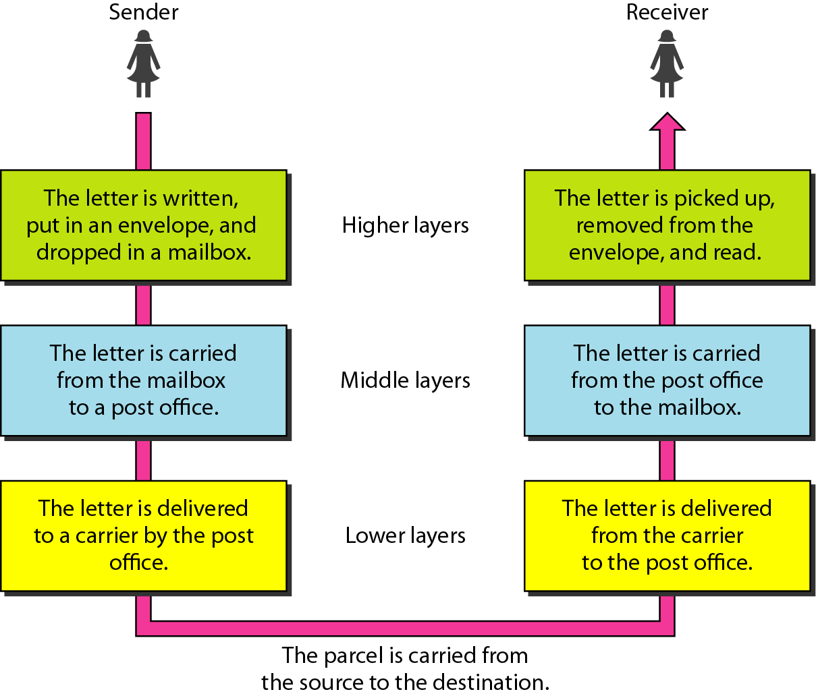
Why layering? Tasks involved in sending a letter can be considered as some layered tasks

Slide 16
Why layering?
dealing with complex systems:
explicit structure allows identification, relationship of complex system’s pieces
layered reference model for discussion
modularization eases maintenance, updating of system
change of implementation of layer’s service transparent to rest of system
e.g., change in gate procedure doesn’t affect rest of system
layering considered harmful?

Slide 17
Internet protocol stack (TCP/IP Stack)
application: supporting network applications
FTP, SMTP, HTTP
transport: process-process data transfer
TCP, UDP
network: routing of datagrams from source to destination
IP, routing protocols
link: data transfer between neighboring network elements
Ethernet, 802.111 (WiFi), PPP
physical: bits “on the wire”
application
transport
network
link
physical

Slide 18
ISO/OSI reference model
presentation: allow applications to interpret meaning of data, e.g., encryption, compression, machine-specific conventions
session: synchronization, checkpointing, recovery of data exchange
Internet stack “missing” these layers!
these services, if needed, must be implemented in application
needed?
application
presentation
session
transport
network
link
physical

Slide 19
Encapsulation
source
message
M
application
transport
network
link
physical
segment
H_{t}
M
H_{t}
datagram
H_{n}
H_{n}
H_{t}
M
frame
H_{l}
H_{n}
H_{t}
M
link
physical
switch
destination
H_{n}
H_{t}
M
network
link
physical
M
application
transport
network
link
physical
H_{l}
H_{n}
H_{t}
M
H_{n}
H_{t}
M
H_{t}
M
H_{n}
H_{t}
M
H_{l}
H_{n}
H_{t}
M
router

Slide 20
Introduction: roadmap
1.1 what is the Internet?
1.2 network edge
end systems, access networks, links
1.3 network core
packet switching, circuit switching, network structure
1.4 delay, loss, throughput in networks
1.5 protocol layers, service models
1.6 networks under attack: security
1.7 history
Notes:
20

Slide 21
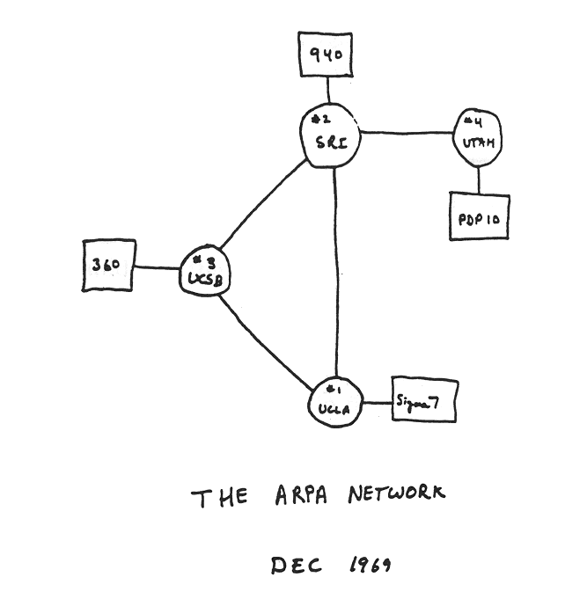
Internet history
1961-1980: Early packet-switching principles
1969: first ARPAnet node operational
1972:
ARPAnet public demo
NCP (Network Control Protocol) first host-host protocol
first e-mail program
ARPAnet has 15 nodes
1970: ALOHAnet satellite network in Hawaii
1974: Cerf and Kahn - architecture for interconnecting networks
1976: Ethernet at Xerox PARC
1979: ARPAnet has 200 nodes

Slide 22
Internet history
1980-1990: new protocols, a proliferation of networks
Cerf and Kahn’s internetworking principles:
minimalism, autonomy - no internal changes required to interconnect networks
best effort service model
stateless routers
decentralized control
define today’s Internet architecture
1983: deployment of TCP/IP
1982: smtp e-mail protocol defined
1983: DNS defined for name-to-IP-address translation
1985: ftp protocol defined
1988: TCP congestion control
new national networks: CSnet, BITnet, NSFnet, Minitel
100,000 hosts connected to confederation of networks

Slide 23
Internet history
1990, 2000’s: commercialization, the Web, new apps
early 1990s: Web
hypertext [Bush 1945, Nelson 1960’s]
HTML, HTTP: Berners-Lee
1994: Mosaic, later Netscape
late 1990’s: commercialization of the Web
late 1990’s – 2000’s:
network security to forefront
est. 50 million host, 100 million+ users
backbone links running at Gbps

Slide 24
Internet history
2005-present
~5B devices attached to Internet (2016)
smartphones and tablets
aggressive deployment of broadband access
increasing ubiquity of high-speed wireless access
emergence of online social networks:
Facebook: ~ one billion users
service providers (Google, Microsoft) create their own networks
bypass Internet, providing “instantaneous” access to search, video content, email, etc.
e-commerce, universities, enterprises running their services in “cloud” (e.g., Amazon EC2)

Slide 25
Introduction: summary
covered a “ton” of material!
Internet overview
what’s a protocol?
network edge, core, access network
packet-switching versus circuit-switching
Internet structure
performance: loss, delay, throughput
layering, service models
security
history
you now have:
context, overview, “feel” of networking
more depth, detail to follow!

Slide 26


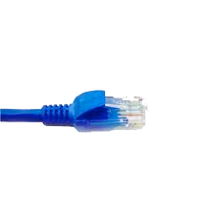
Network Monitoring: Wire Shark
application
(www browser,
email client)
packet
analyzer
application
OS
packet
capture
(pcap)
Transport (TCP/UDP)
Network (IP)
Link (Ethernet)
Physical
copy of all Ethernet frames sent/received

